Slide 1
What Happened in Our AIL Classroom
Ms. MacDonald and Mr. Behm’s Class

Slide 2
Student Learning

Slide 3
Learning to Draw Face Structures and Emotions

Slide 4
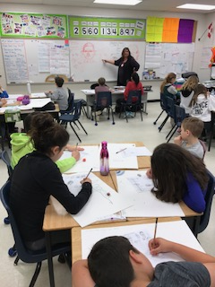

Slide 5
Working on Final Draft

Slide 6
Student Collaboration

Slide 7
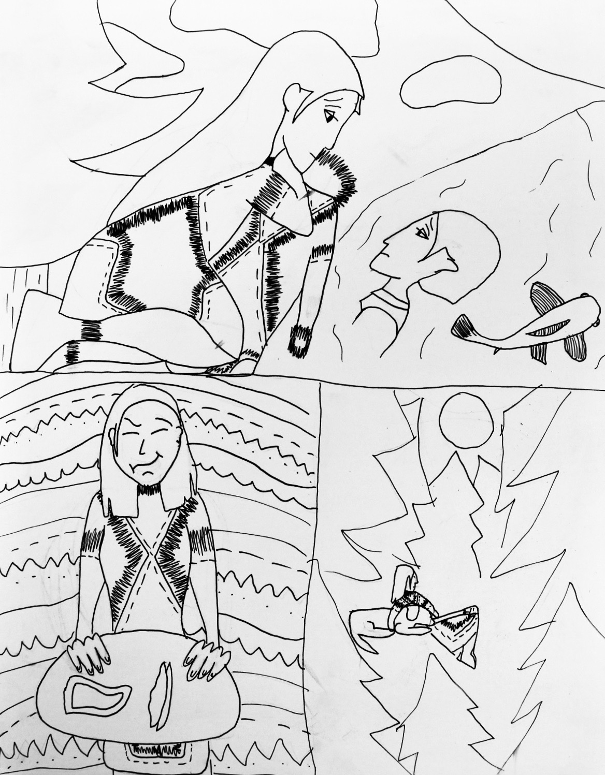
Final Products

Slide 8
Student Quotes
“I can’t believe something like this happened in Canada”
“I can connect this experience to my own culture”
“I like using pictures to tell this story”
“My favourite books to read are graphic novels so I am glad we are making a graphic novel”

Slide 9
Quotes Continued
“I want to do something to help. It is terrible the way First Nations people were treated.”
“This connects to the acknowledgement we read every morning”

Slide 10
Board Office Display

